Slide 1
Module 3: Collections & Generics / Data Structure
A BPI Training Program
‹#›

Slide 2
Topics
• Collections Overview
• List, Set, Map, Queue Interfaces
• Iteration and Enhanced For-Loop
• Generics: Type Safety and Flexibility
• Functional Interfaces and Lambda Expressions
• Summary & Q&A
Notes:
‹#›

Slide 3
Objectives
Understand the concept of Collections
Learn the hierarchy and core interfaces of Collections
Explore common implementations of Collections
Practical usage of each implementations of Collections
Learn about Generics and Type Safety
Learn basic knowledge about Functional Interfaces and Lambda Expressions
Notes:
‹#›

Slide 4
Collections Overview
Notes:
‹#›

Slide 5
Java Collections Overview
What is Collection in Java?
- A Collection in Java is a group of objects, like a container that holds multiple items together.
- It helps in storing, retrieving, and manipulating data easily.
Notes:
‹#›

Slide 6
Java Collections Overview
Why Use Collection?
Organizing and grouping
Dynamic in size
Built-in methods ( add(), remove(), contains(), size(), sort() etc. )
Type Safety
Variety of Data Structures (List, Set, Map, Queue)
Easy Iteration
Ready for Advanced Operations (Streams, Sorting and Searching)
Notes:
‹#›

Slide 7
Java Collections Overview
Limitation of Collections
No Support for Primitive Data Types
Not Thread-Safe by Default
Performance Limitations and Higher Memory Usage
Limited Index Access
Notes:
‹#›

Slide 8
Java Collections Overview
Common Methods
Method | What it Does
add(element) | Add an element
remove(element) | Remove an element
get(index) | Get element by index (List only)
contains(element) | Check if element exists
size() | Number of elements
clear() | Remove all elements
isEmpty() | Check if collection is empty
Notes:
‹#›

Slide 9
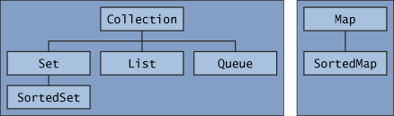
Java Collections Framework
The Collections Framework in Java is a group of interfaces and classes that make handling data simple and powerful.
Notes:
‹#›

Slide 10
List, Set, Map, Queue Interfaces
Notes:
‹#›

Slide 11
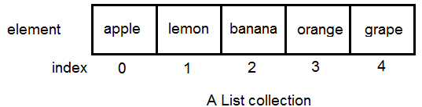
List Interface
List
- is an ordered collection that allows duplicate elements.
- Elements can be accessed by their position (index).
Notes:
‹#›

Slide 12
ArrayList
ArrayList
- is a linear data structure that stores a collection of data elements in a contiguous memory location.
- Elements are stored sequentially and can be accessed using their index.
- Internally, it uses a resizable array to store elements, allowing dynamic resizing when the capacity is exceeded.
- The first element is at index 0, and the last element is at index size - 1.
Notes:
‹#›

Slide 13
ArrayList
When To Use ArrayList?
You need fast random access
You mostly add elements at the end
You do not frequently insert/delete in the middle
You want a resizable array
Notes:
‹#›

Slide 14
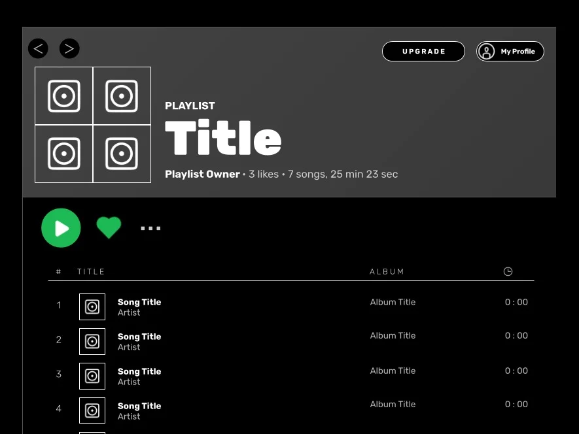
ArrayList
Practical application of ArrayList (Example)
Music/Songs Playlist
Notes:
‹#›

Slide 15
ArrayList
How to Instantiate an ArrayList?
List<String> studentList = new ArrayList<>();
List<String> studentList = Arrays.asList(“Alice”, “Bob”, “Charlie”);
Notes:
‹#›

Slide 16
LinkedList
LinkedList
- is a linear data structure that stores a collection of data elements dynamically. - Nodes represent those data elements and references that connect each node.
Notes:
‹#›

Slide 17
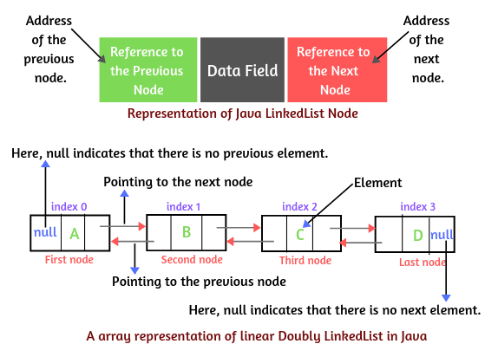
LinkedList
Notes:
‹#›

Slide 18
LinkedList
When To Use LinkedList?
You need frequent insertions/deletions in the middle of the list
You care about stable references to elements
You mostly move through the list from start to end and you don’t need to access the elements by their index.
Notes:
‹#›

Slide 19

LinkedList
Practical Application of LinkedList (Example)
Undo / Redo functionality in text editors
Notes:
‹#›

Slide 20
ArrayList
How to Instantiate a LinkedList?
List<String> studentList = new LinkedList<>();
List<String> studentList = new
LinkedList<>(Arrays.asList(“Alice”, ”Charlie”,“Bob”));
Notes:
‹#›

Slide 21
LinkedList
ArrayList vs LinkedList
Operation (Java) | ArrayList | LinkedList
get(i) (random access) | ✔ O(1) | ✘ O(n)
set(i) | ✔ O(1) | ✘ O(n)
add(E) at end | ✔ O(1)* | ✔ O(1)
add(i, E) in middle | ✘ O(n) | ✔/✘ O(n) traversal, O(1) insert
remove(i) in middle | ✘ O(n) | ✔/✘ O(n) traversal, O(1) delete
add/remove at start | ✘ O(n) | ✔ O(1)
iteration | ✔ fast | ✘ slower
memory usage | ✔ low | ✘ high (node overhead)
Notes:
‹#›

Slide 22
LinkedList
How To Go Through The List?
While & do while
Traditional For-Loop using index
Enhanced For-loop
Iterator
For-each (Java 8)
List<String> fruits = Arrays.asList("apple", "banana", "cherry");
for (int i = 0; i < fruits.size(); i++) {
System.out.println(fruits.get(i));
}
Notes:
‹#›

Slide 23
List
Activity #1: Product List (M3_ACTIVITY1)
Goal: Practice List Operations
Task:
1. Create a List of Products with 5 records
- Laptop, Mouse, Keyboard, Monitor, Printer
2. Print all products
3. Add a new product (Webcam) and remove one product (Mouse) and print the updated list.
4. Find a product by name using two ways. You can use either
4.1. Traditional for-loop
4.2. contains() method
Notes:
‹#›

Slide 24
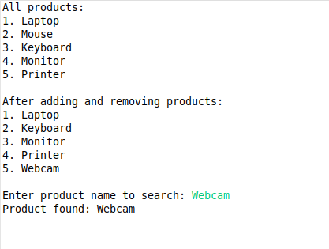
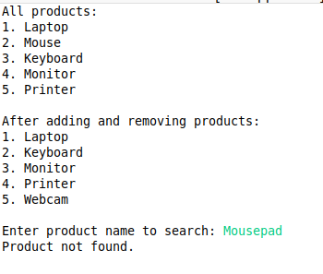
List
Activity #1: Product List (Expected Result)
Notes:
‹#›

Slide 25
Set Interface
Set
Is an unordered collection that does not allow duplicate elements.
Elements cannot be accessed by index, because there is no guaranteed order.
Notes:
‹#›

Slide 26
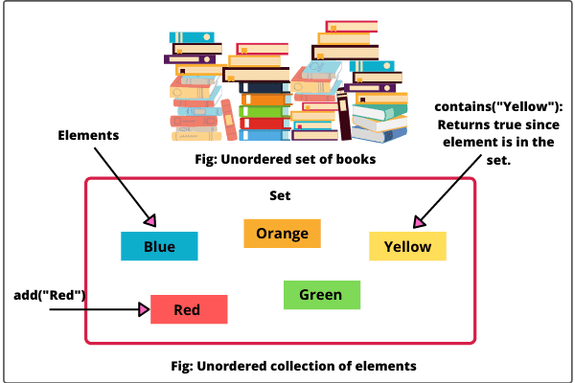
Set Interface
Notes:
‹#›

Slide 27
Set Interface
HashSet
A collection that stores unique elements using a hash table.
No guaranteed order and no index access.
Fast add, remove, and lookup operations.
Notes:
‹#›

Slide 28
Set Interface
When To Use HashSet?
You need to prevent duplicates automatically
You need fast checking if a record exists
You are not concerned with the order of the elements
Notes:
‹#›

Slide 29

Set Interface
Practical Application of HashSet (Example)
User Registration
Notes:
‹#›

Slide 30
Set Interface
LinkedHashSet
Stores unique elements using a hash table with a linkedList to maintain insertion order.
Elements cannot be accessed by index.
Slightly slower than HashSet due to ordering.
Notes:
‹#›

Slide 31
Set Interface
When To Use LinkedHashSet?
Duplicates are not allowed
Order matters
Fast lookups
Iteration in order
Notes:
‹#›

Slide 32

Set Interface
Practical Application of LinkedHashSet (Example)
Event Logs
Notes:
‹#›

Slide 33
Set Interface
TreeSet
Stores unique elements in sorted order.
Slower than HashSet and LinkedHashSet, but keeps things sorted
Notes:
‹#›

Slide 34
Set Interface
When To Use TreeSet?
Unique Items
You need items in sorted order
Range queries
Notes:
‹#›

Slide 35

Set Interface
Practical Application of TreeSet (Example)
Scheduling events or appointments
Notes:
‹#›

Slide 36
Set Interface
EnumSet
Special Set for enum types only
Very fast and memory-efficient
Notes:
‹#›

Slide 37
Set Interface
When To Use EnumSet?
You have a fixed set of constants and unique enum values
Fast set operations
Compact memory usage
Notes:
‹#›

Slide 38

Set Interface
Practical Application of EnumSet?
User Roles or Permissions
Notes:
‹#›

Slide 39
Set Interface
HashSet vs LinkedHashSet vs TreeSet vs EnumSet
Set Type | Order Maintained? | Speed | Null Allowed? | Special Feature | When To Use
HashSet | ❌ No order | ⭐ Fastest (O(1)) | ✔ Yes | Uses hashing | Use when you want fastest performance and don’t care about order.
LinkedHashSet | ✔ Insertion order | ⭐ Fast (slightly slower than HashSet) | ✔ Yes | Keeps elements in the order they were added | Use when you need fast performance AND want to preserve insertion order.
TreeSet | ✔ Sorted order | ⚠ Slower | ❌ No (by default) | Automatically sorts elements | Use when you need sorted elements (A–Z, 1–100, etc.).
EnumSet | ✔ Natural order of enum | ⭐⭐⭐ Fastest of all | ❌ No null | Only for enums | Use when filtering, grouping, or storing enum values efficiently.
Notes:
‹#›

Slide 40
Set Interface
How to go through the Set?
Using an Enhanced For-Loop
Set<String> fruitSet = new HashSet<>();
set.add("Apple");
set.add("Banana");
set.add("Cherry");
for (String fruit : fruitSet) {
System.out.println(fruit);
}
Notes:
‹#›

Slide 41
Set Interface
How to go through the Set?
Iterator
For-each with Lambda (Java 8+)
Java Streams (Java 8+)
Notes:
‹#›

Slide 42
Set Interface
Activity #2: Practice Set Operations (M3_ACTIVITY2)
Goal: Practice Set Operations
Task:
1. Create a HashSet of Products with 5 initial data
2. Display the menu repeatedly until the user choose to exit.
3. Provide implementation for each options
Select an option:
1. Search a product
2. Add a product
3. Print all products and count
4. Exit
Notes:
‹#›

Slide 43
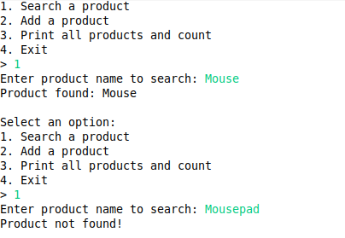
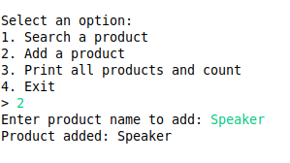
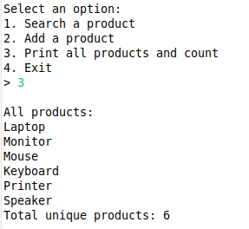
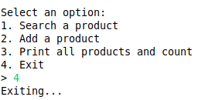
Activity #2: Example Output
Search a product
2. Add a product
3. Print all products and count
4. Exit

Slide 44
Map Interface
Map
A collection that stores key-value pairs.
Keys are unique, but values can be duplicated.
Elements are accessed by key, not by index.
No guaranteed order in some implementations.
Notes:
‹#›

Slide 45
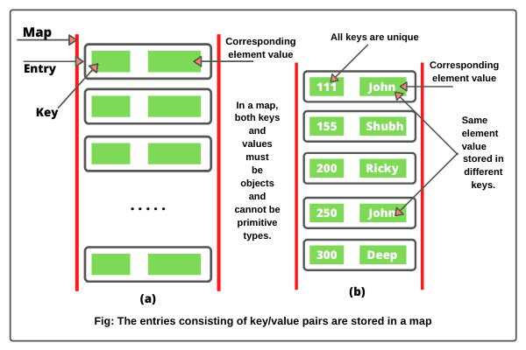
Map Interface
Notes:
‹#›

Slide 46
Map Interface
HashMap
Stores key-value pairs.
Keys are unique; values can be duplicated.
No order of keys
Fast to add, remove, or lookup by key.
Notes:
‹#›

Slide 47
Map Interface
When To Use HashMap?
You need fast lookups by key
You want to associate values with unique keys
You need to update/remove values efficiently
You need key-value structure without caring about the order
Notes:
‹#›

Slide 48

Map Interface
Practical Application of HashMap (Example)
Phone Contacts
Key = Contact Name
Value = Contact Number
Notes:
‹#›

Slide 49
Map Interface
LinkedHashMap
Stores key-value pairs.
Keys are unique; values can be duplicated.
Keeps insertion of order of keys
Slightly slower than HashMap due to ordering
Notes:
‹#›

Slide 50
Map Interface
When To Use LinkedHashMap?
You need key-value pairs with insertion order
You need fast lookups by key
You want predictable iteration order
Notes:
‹#›

Slide 51
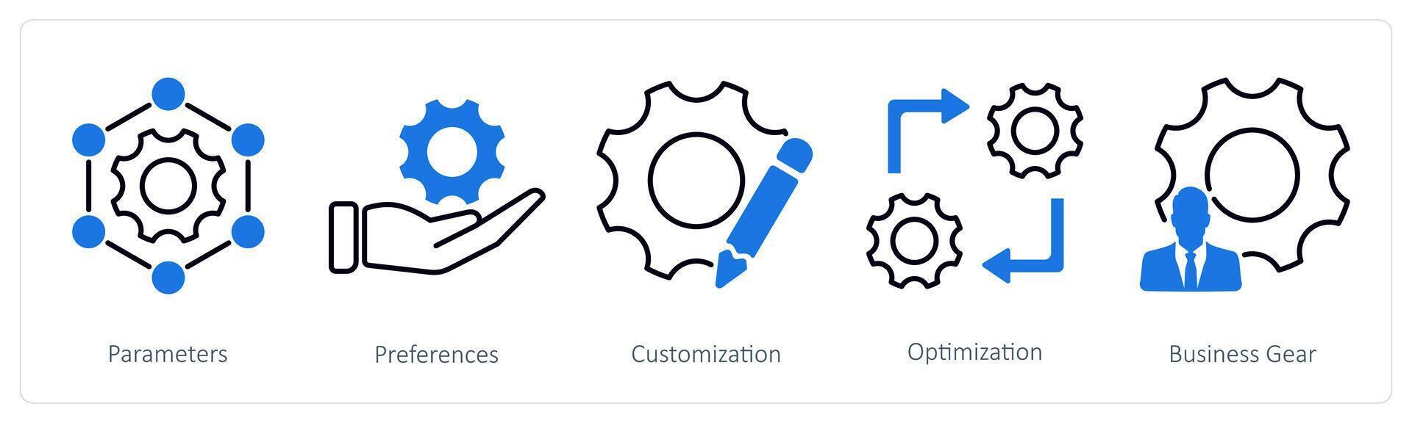
Map Interface
Practical Application of LinkedHashMap (Example)
Configuration Settings or Preferences
Notes:
‹#›

Slide 52
Map Interface
TreeMap
Stores key-value pairs in sorted order of keys.
Slower than HashMap/LinkedHashMap because it keeps keys sorted.
Notes:
‹#›

Slide 53
Map Interface
When To Use TreeMap?
You need sorted keys
You want range queries
You need first/last key access [ firstKey() and lastKey() ]
You need a naturally ordered map
Notes:
‹#›

Slide 54

Map Interface
Practical Application of TreeMap?
Dictionary
Notes:
‹#›

Slide 55
Map Interface
EnumMap
Special Map for enum keys only.
Very fast and memory-efficient.
Keys must be enum constants.
Notes:
‹#›

Slide 56
Map Interface
When To Use EnumMap?
Keys are from a fixed set of constants
You want fast and efficient maps
You want type-safety
You need predictable iteration order
Notes:
‹#›

Slide 57

Map Interface
Practical Application of EnumMap (Example)
Traffic Lights
Enum (RED, YELLOW, GREEN)
Value (Duration in seconds)
Notes:
‹#›

Slide 58
Map Interface
How To Iterate Through A Map?
Iterate through keys only (keySet)
Iterate through values only (values)
for (Integer key : products.keySet()) {
System.out.println("Key: " + key);
}
for (String value : products.values()) {
System.out.println("Value: " + value);
}
Notes:
‹#›

Slide 59
Map Interface
Iterate through key + value (entrySet)
Using forEach (Java 8+)
for (Map.Entry<Integer, String> entry : products.entrySet()) {
System.out.println(entry.getKey() + " = " + entry.getValue());
}
Notes:
‹#›

Slide 60
Map Interface
Activity #3: Practice Map Operations (M3_ACTIVITY3)
Goal: Practice Map Operations
Task:
1. Create a Map of products with 5 initial records
(Key = product name, Value = product price)
2. Display a menu repeatedly until user chooses to exit.
3. Create implementation for each options.
Select an option:
1. Search a product
2. Add a product
3. Print all products and prices
4. Find the cheapest product
5. Exit
Notes:
‹#›

Slide 61
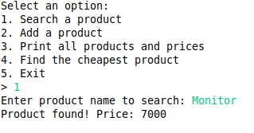
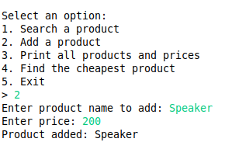
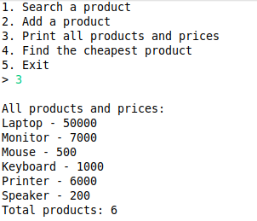
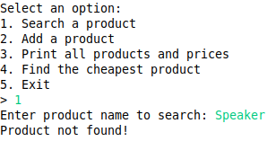
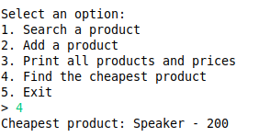
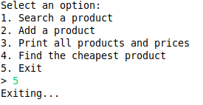
Activity #3: Sample Output
Search a product
2. Add a product
3. Print all products and prices
4. Find the cheapest product
5. Exit

Slide 62
Queue Interface
Queue
A collection that stores elements in FIFO (First-In-First-Out) order.
Elements are added at the end (rear) and removed from the front.
Duplicates are allowed.
Common operations: add() / offer() (add), remove() / poll() (remove), peek() (view front element).
Implementations include LinkedList, PriorityQueue, ArrayDeque, etc.
Notes:
‹#›

Slide 63
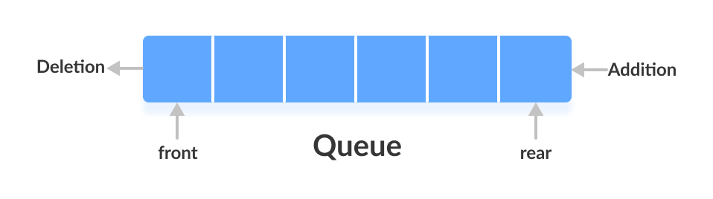
Queue Interface
Notes:
‹#›

Slide 64
Queue Interface
LinkedListQueue
A queue implementation using a linkedList.
Stores elements in FIFO (First-In-First-Out) order.
Elements are added at the end (rear) and removed from the front.
Duplicates are allowed.
Null elements are allowed
Notes:
‹#›

Slide 65
Queue Interface
When To Use LinkedListQueue?
You need First-In First-Out (FIFO) behavior
Frequent addition and removals
You don’t need random access
Dynamic Size
Notes:
‹#›

Slide 66

Queue Interface
Practical Application of LinkedListQueue
Print Job Management
Notes:
‹#›

Slide 67
Queue Interface
PriorityQueue
Stores elements according to their natural order or a custom comparator.
Elements with higher priority are removed first, not necessarily in insertion order.
Duplicates are allowed.
Null elements are not allowed
Good for priority-based scheduling or task management.
Notes:
‹#›

Slide 68
Queue Interface
When To Use PriorityQueue?
You need to process elements by priority
Tasks scheduling based on priority
Dynamic ordering
You want fast access to the highest or least priority items
Notes:
‹#›

Slide 69

Queue Interface
Practical Application of PriorityQueue (Example)
Hospital Emergency Room (ER)
Notes:
‹#›

Slide 70
Queue Interface
ArrayDequeQueue
Implements a resizable double-ended queue (Deque) used as a queue.
Stores elements in FIFO (First-In-First-Out) order.
Elements are added at the tail and removed from the head.
Duplicates are allowed but preserves insertion order
Null elements are not allowed
Faster than LinkedList for queue operations; preferred for high-performance queues.
Notes:
‹#›

Slide 71
Queue Interface
When To Use ArrayDequeQueue?
You need a simple FIFO queue
You want a double-ended queue
You want better performance than LinkedList
Notes:
‹#›

Slide 72
Queue Interface
Practical Application of ArrayDequeQueue (Example)
Undo / Redo functionality in Text Editors
Notes:
‹#›

Slide 73
Iteration and Enhanced For-Loop
Notes:
‹#›

Slide 74
Iterating Collections
Iteration: process of visiting each element in a collection sequentially.
Collections can be iterated using:
Traditional for-loop (only works with List using index)
Iterator
Enhanced for-loop (simplest way)
Notes:
‹#›

Slide 75
Iterating Collections
Traditional For-Loop
Syntax
for (int i = 0; i < collection.size(); i++) {
// access element at index i
}
Works well with List because it supports index-based access.
Cannot be used directly for Set or Queue (no index)
Notes:
‹#›

Slide 76
Iterating Collections
Iterator
An Iterator is an object that allows traversal of a collection regardless of type.
Syntax
Iterator<Type> it = collection.iterator();
while (it.hasNext()) {
Type element = it.next();
// process element
}
Works well with all collections (List, Set, Queue)
Safe removal of elements during iteration (it.remove()).
Notes:
‹#›

Slide 77
Iterating Collections
Enhanced For-Loop (For-Each Loop)
Introduced in Java 5 for simpler, cleaner iteration.
Automatically traverses all elements without needing index or iterator object.
Syntax
for (Type element : collection) {
// process element
}
Works well with all collections (List, Set, Queue)
Safe removal of elements during iteration (it.remove()).
Notes:
‹#›

Slide 78
Iterating Collections
Limitations of Enhanced For-Loop
Cannot access elements by index. Use a traditional for-loop instead.
Cannot remove elements during iteration. Use iterator instead.
Notes:
‹#›

Slide 79
Iterating Collections
Iterating Maps
Maps are not directly iterable. Use entrySet() with enhanced for-loop or iterator
Notes:
‹#›

Slide 80
Generics: Type Safety and Flexibility
Notes:
‹#›

Slide 81
Generics: Type Safety and Flexibility
What are Generics?
Generics let you create classes, interfaces, and methods that can work with any data type.
They help you write reusable, flexible and type-safe code.
Example: Instead of creating separate classes like BookBox, ToyBox, and FruitBox, you can make one generic class — Box<T> — that works for any type of item.
Notes:
‹#›

Slide 82
Generics: Type Safety and Flexibility
Why Do We Need Generics?
Before generics, we used Object types to store any data.
But this caused problems — you had to cast types manually and risked runtime errors.
Generics check types at compile-time, preventing errors before the program runs.
Notes:
‹#›

Slide 83
Generics: Type Safety and Flexibility
How Generics Fix This?
List<String> list = new ArrayList<>();
list.add("Hello");
String str = list.get(0); // Safe and no casting needed
The compiler knows the list holds Strings only, so it prevents type mistakes early.
Notes:
‹#›

Slide 84
Functional Interfaces and Lambda Expressions
Notes:
‹#›

Slide 85
Functional Interfaces and Lambda Expressions
What is a Functional Interface
An interface with only one method
Can have default and static methods, but only one abstract method
Used as a target type for lambda expressions
Notes:
‹#›

Slide 86
Functional Interfaces and Lambda Expressions
Why Functional Interfaces?
Helps in writing concise code
Enables functional programming in Java
Used as a target type for lambda expressions
Notes:
‹#›

Slide 87
Functional Interfaces and Lambda Expressions
Common Built-in Functional Interface
Interface | Method | Description
Runnable | void run() | No input, no output
Supplier<T> | T get() | Returns a value
Consumer<T> | void accept(T t) | Takes input, no output
Function<T,R> | R apply(T t) | Takes input, returns output
Predicate<T> | boolean test(T t) | Returns boolean
Notes:
‹#›

Slide 88
Functional Interfaces and Lambda Expressions
What is Lambda Expressions?
A short block of code representing a functional interface instance
Syntax:
(parameters) -> expression_or_block
Notes:
‹#›

Slide 89
Functional Interfaces and Lambda Expressions
Lambda Expression Syntax
No parameters
() -> System.out.println("Hello!");
One parameter
x -> x * x
Multiple parameters
(a,b) -> a + b
Multiple statements
(a, b) -> {
int sum = a + b;
return sum;
}
Notes:
‹#›

Slide 90
Functional Interfaces and Lambda Expressions
Why Use Functional Interfaces & Lambda Expressions with Collections
Collections often store multiple elements
We frequently want to iterate, filter, transform or aggregate elements
Java 8+ Streams and lambda expressions make this easy and readable
Notes:
‹#›

Slide 91
Functional Interfaces and Lambda Expressions
Functional Interfaces Commonly Used with Streams
Functional Interface | Method Signature | Use Case
Consumer<T> | void accept(T t) | forEach() – iterate and process elements
Predicate<T> | boolean test(T t) | filter() – keep certain elements
Function<T,R> | R apply(T t) | map() – transform elements
Supplier<T> | T get() | Provide data lazily
Comparator<T> | int compare(T a, T b) | Sorting streams
Notes:
‹#›

Slide 92
THANK YOU!
Any Questions / Clarifications?
Notes:
‹#›

